Slide 1
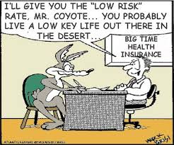
Allstate Severity Prediction
How severe is an insurance claim?
-Tony Schroeder

Slide 2
Overview:
My tools
Gathering and cleaning data
Exploring and visualizing data
Create baseline model
Feature creation and selection
Create final model & Predictions
Communicate results
Reflections

Slide 3
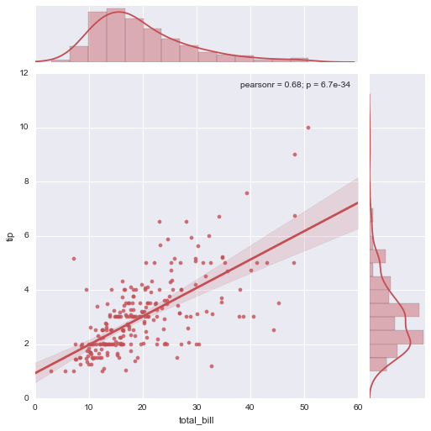
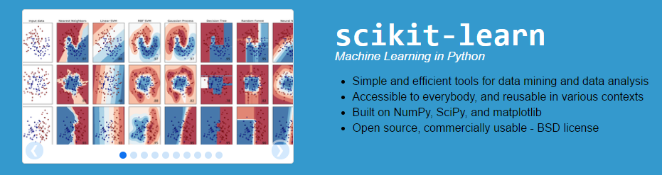
My tools
Mainly Python (most popular data analysis programming language)
Data manipulation
Pandas – SQL-like library to read in data and quickly manipulate to create pivot tables or reorganize data in different ways
Visualization
Seaborn, matplotlib
Model-building
SciPy, StatsModels – basic statistical tools
Scikit-learn – huge breadth of basic machine learning tools such as linear models, decision tree models, SVMs, clustering models, and many more
Keras – neural networks
XGBoost – very fast and accurate gradient boosting decision/regression tree library (great as a baseline model)

Slide 4
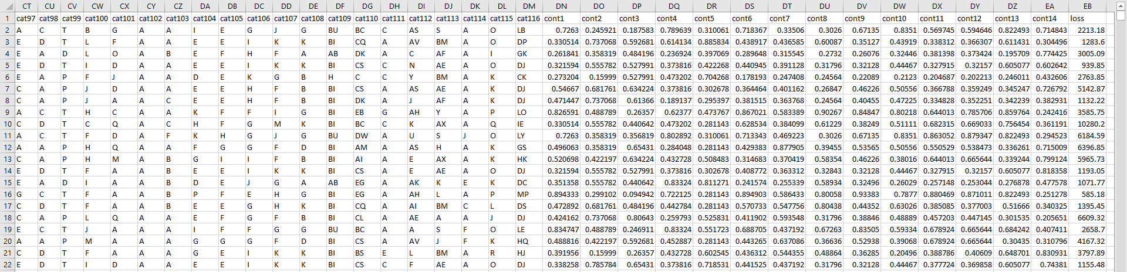
Gathering Data
Labeled data was provided by Allstate in tabular format (.csv)
2 files (1 with labelled data, 1 without labelled data)
Intentionally unlabeled and anonymized features
116 categorical features (likely: sex, state, # household members, etc.)
14 continuous features (likely: salary, length of time since last claim, etc.)
Loss ← This is the quantity to be predicted!
Labelled for some data and unlabeled for test set to see how accurate a model can get (measured by mean absolute error [MAE] between prediction and actual)

Slide 5
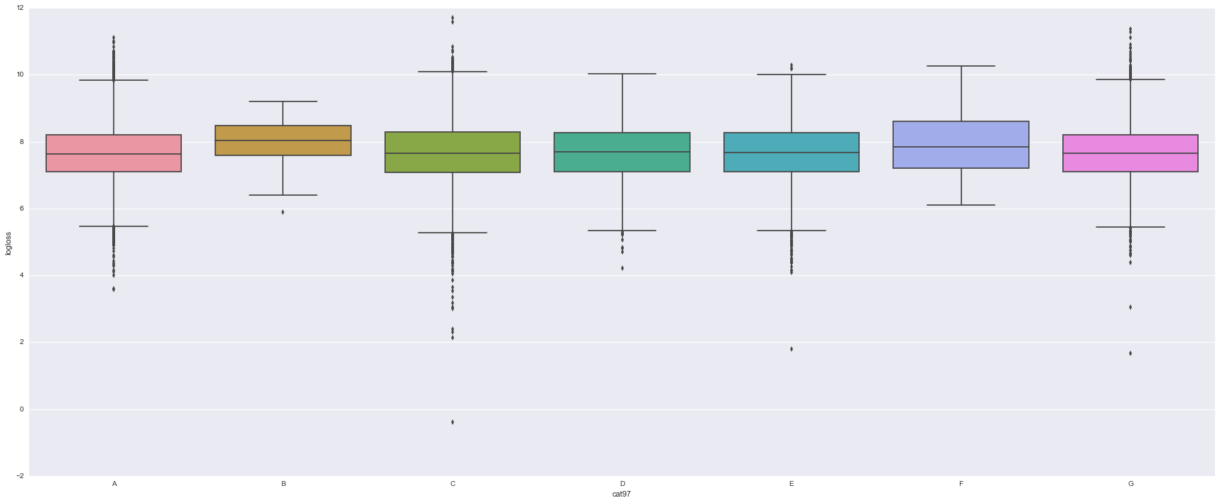
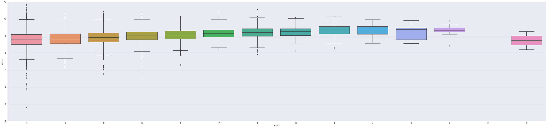
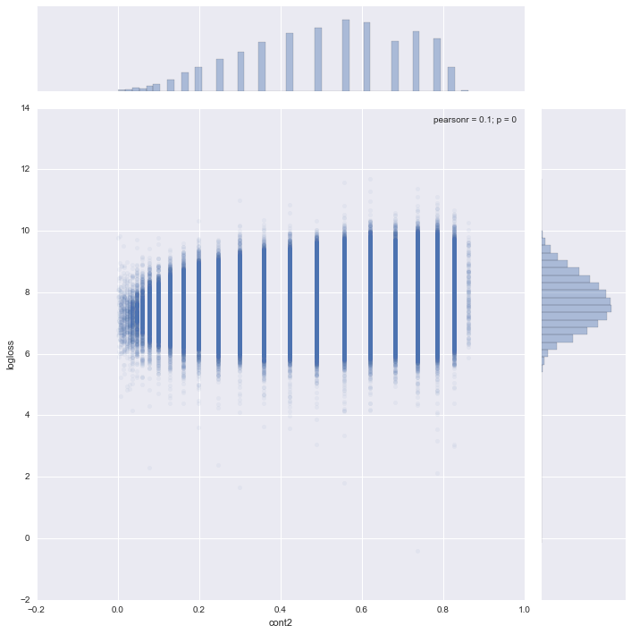
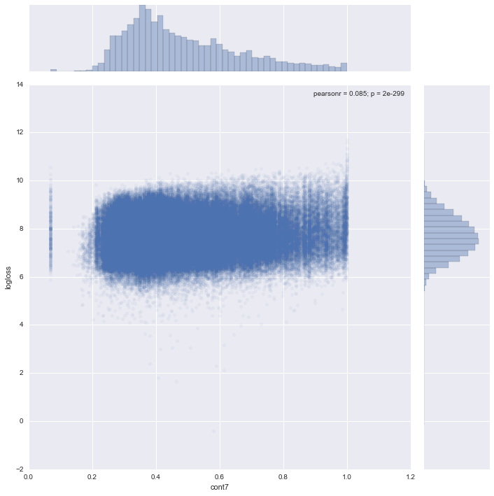
Cleaning Data
Some minor data problems in this project.
Categorical data:
Some features are ordered and some are unordered
But all labelled with letters
Numerical data:
Some features are spaced out and some are distributed evenly
However, no missing or blatantly incorrect values! (often problematic)

Slide 6
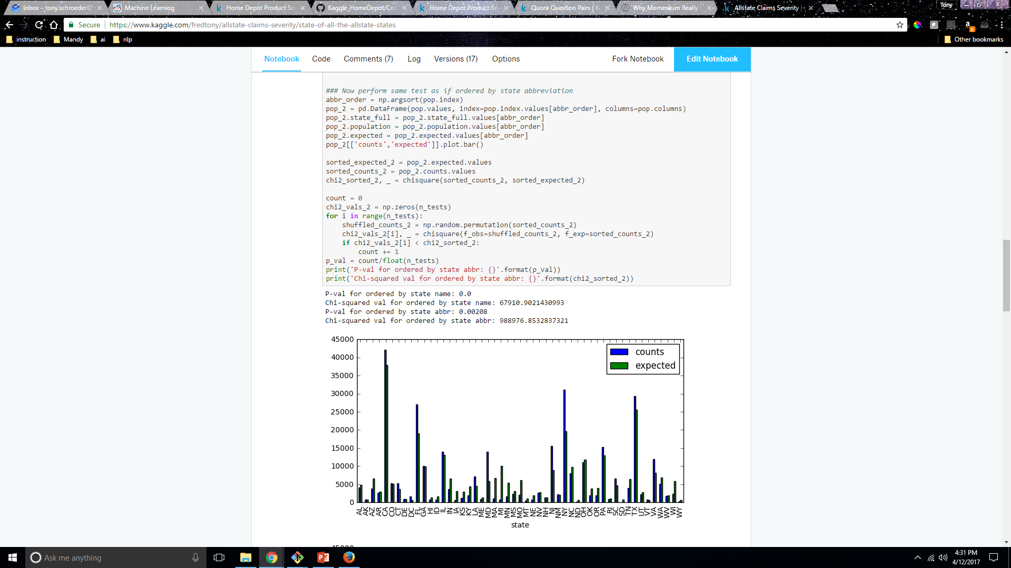
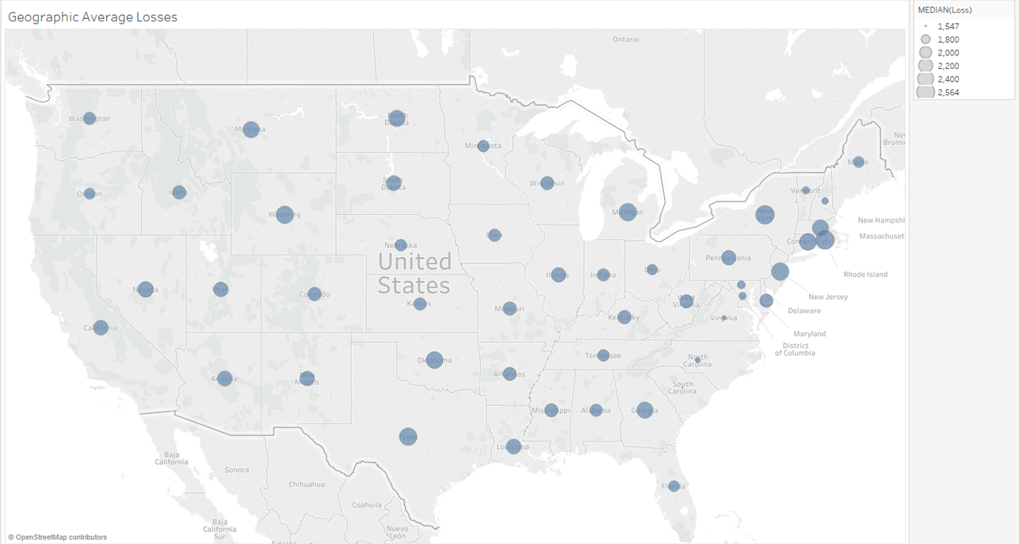

Exploring Data
Through exploration, discovered the meaning of some of the variables, i.e. state variable, which gives greater ability to engineer features of the data
Through exploration, discovered the meaning of some of the variables, i.e. state variable, which gives greater ability to engineer features of the data
Also gives focus areas to pinpoint geographical losses more accurately

Slide 7
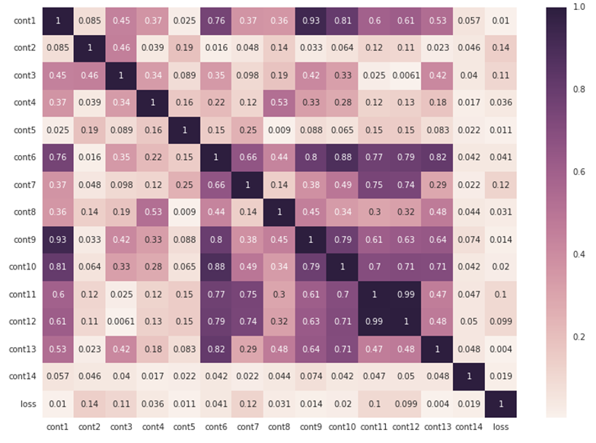
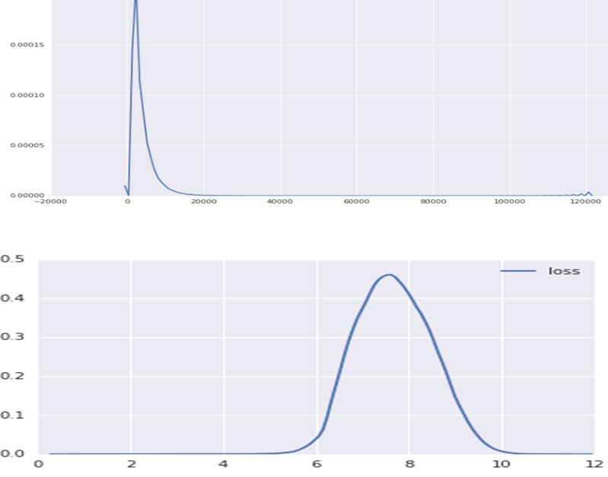
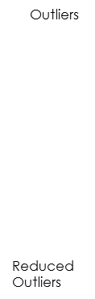

Exploring Data
Statistical analysis:
The 2 sets of data had similar distributions (important to ensure the model can be generalized to all data and not just this set of data)
Using logarithm of loss value to help model the problem smoothed the outliers for claim severity
Find correlations amongst variables and severity of loss

Slide 8
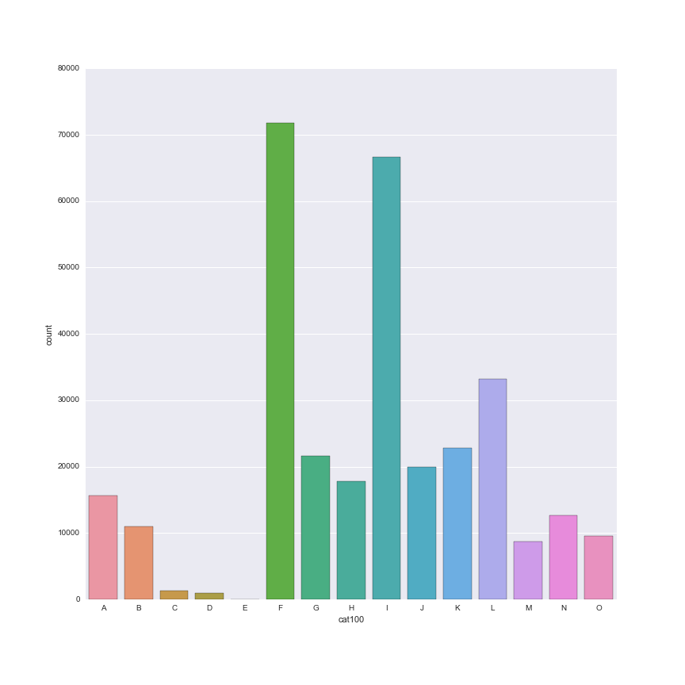
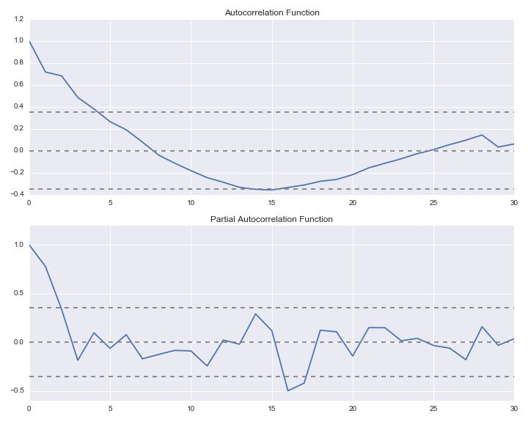
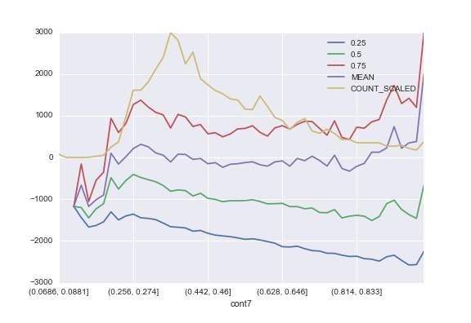
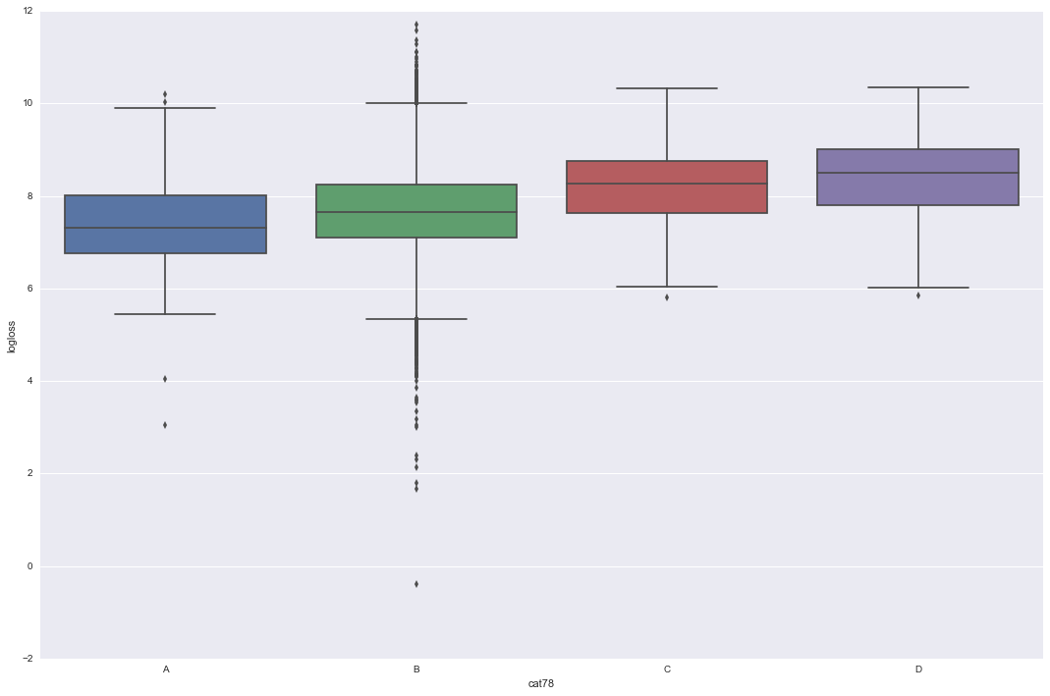
Visualizing Data
Univariate distributions
Bivariate distributions
Time series analysis on continuous features led to insights about features that were clearly related to dates.
Residual plots to try to discover any nonlinearities in the features

Slide 9
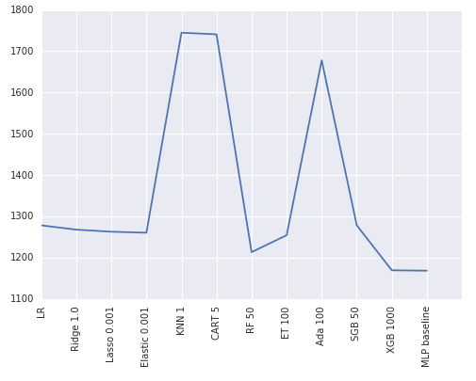
Baseline Model
Tried various simple approaches to find a quick baseline. Best performing baseline models without much feature creation or tuning were:
Neural networks
XGBoost
Random Forests and linear models were not too far behind (although 50-100 more away)

Slide 10
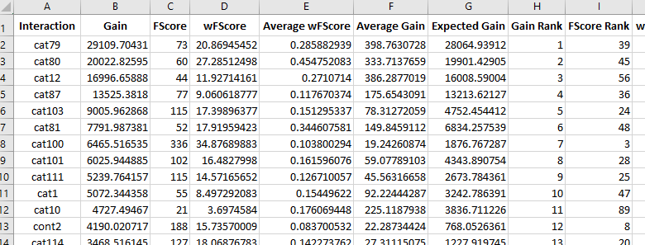
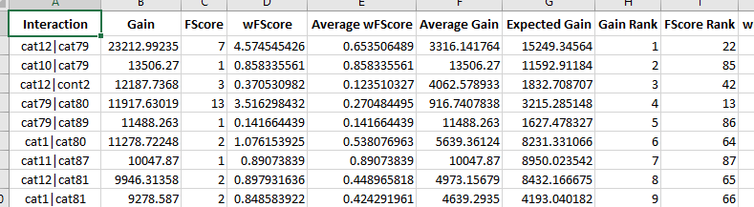
Feature Creation and Selection
Hard to create new features from scratch considering that they were anonymous
Combined features in various ways
Tree models can easily show non-linear interactions (although they do not show the type of non-linearity)
They also help discover important features
Other feature selection tools attempted were PCA and greedy search (drop out or add features one by one)

Slide 11
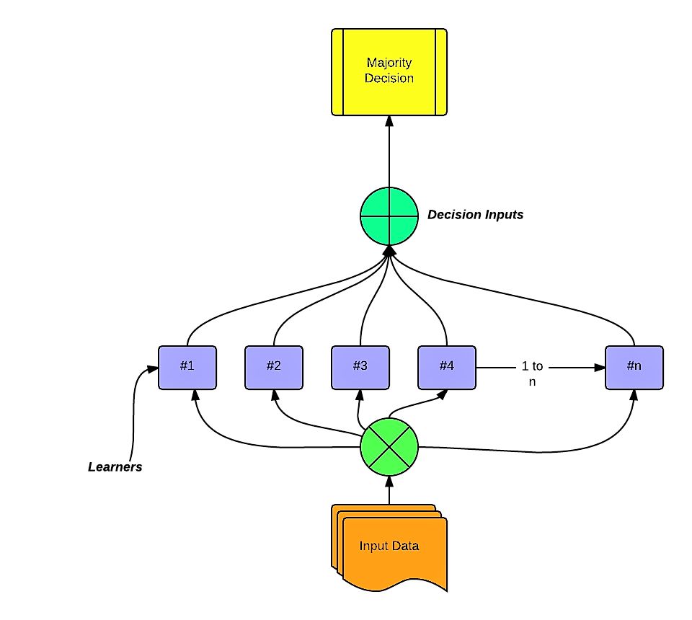
Final Results
Ensembling:
Taking perspectives of various types of models that are better at predicting various parts of the problem (i.e. one model might be very good at predicting outliers, while another might be very good at spotting connections between the variables that influence the severity of the claim)
Final model included:
Neural networks of various architectures
XGBoost with various tuning parameters
Different loss functions helped some models with different outliers
More complicated feature engineering (bivariate and trivariate combinations)
Models trained on different metrics (which helped with different types of outliers)
My final score with the ensembled model:
1114.40 mean absolute error (each prediction was off on average $1114.40)
189th out of 3055 people that entered competition
Winning score was 1109.71

Slide 12
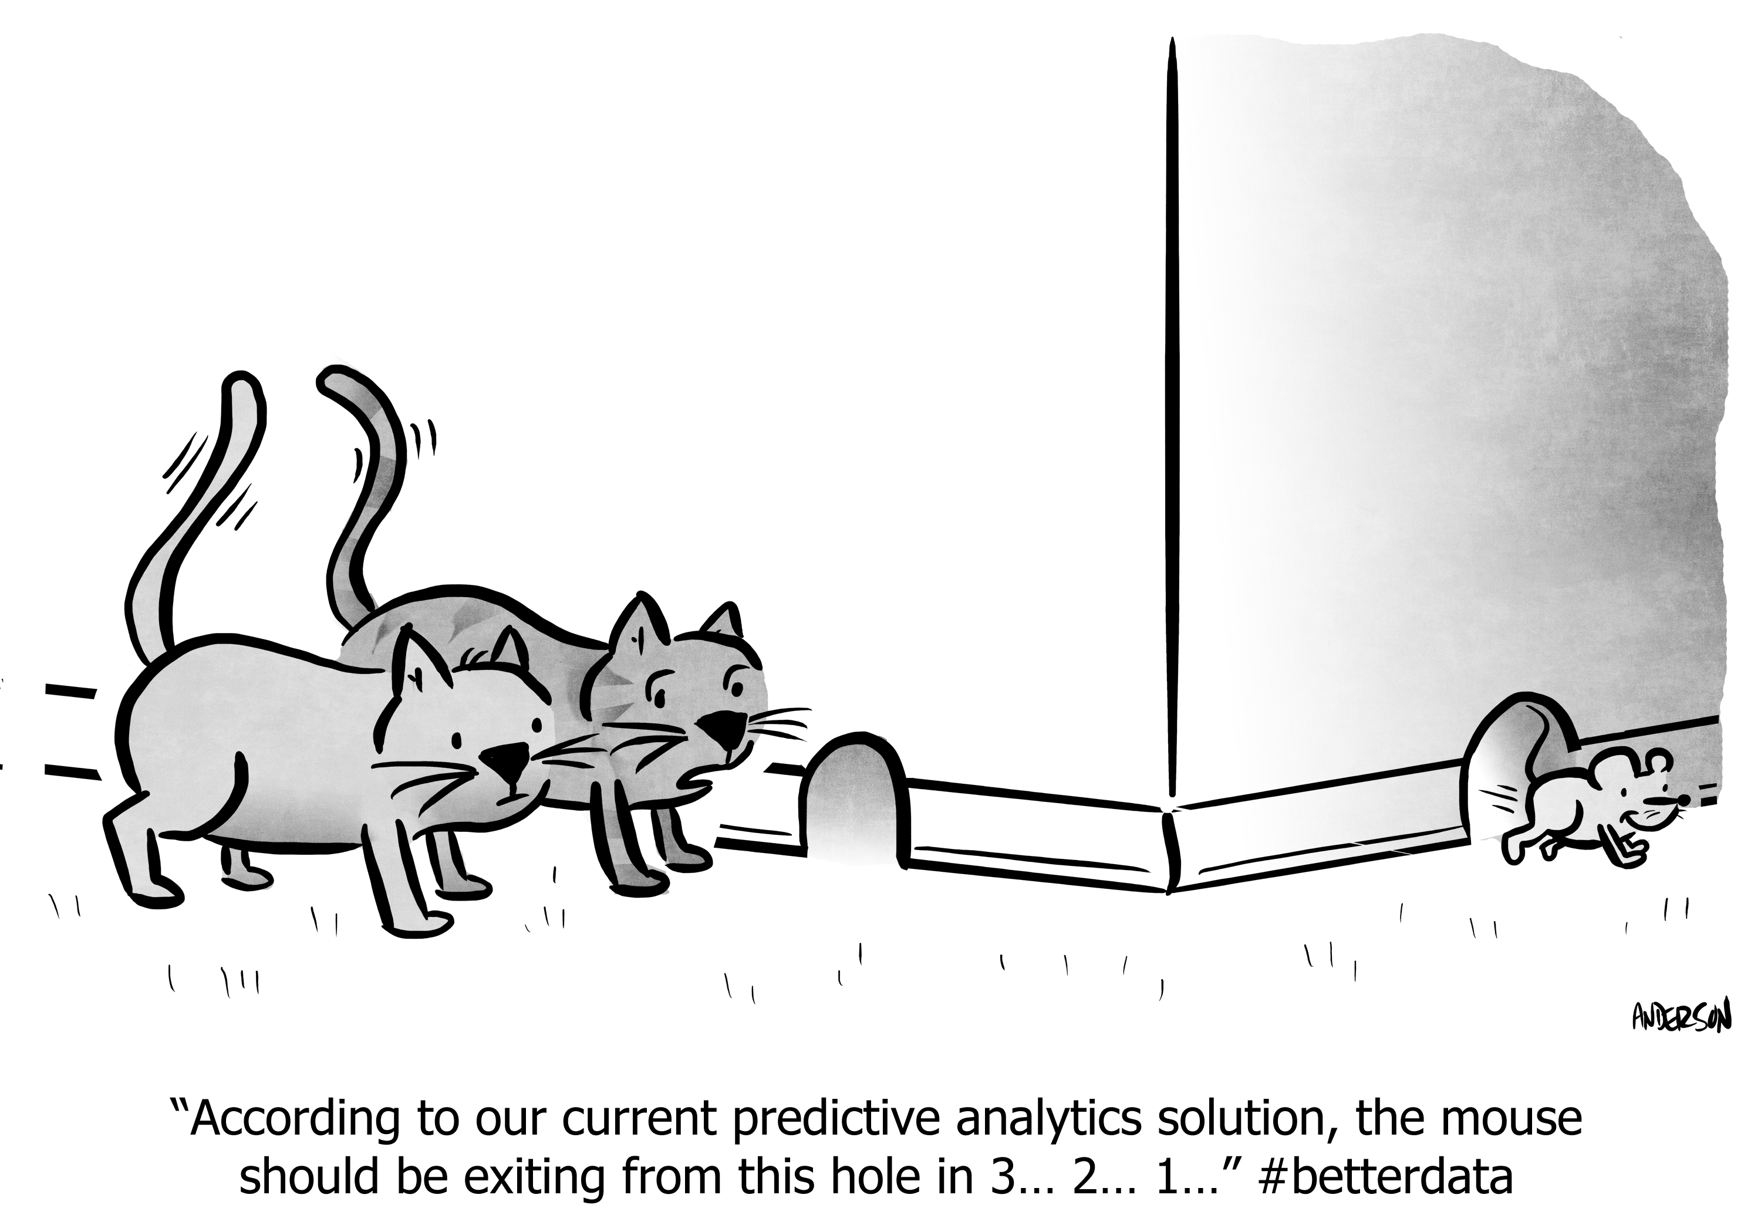
Reflections
More accurate predictions are a double benefit:
Insurance providers get more accurate estimates of claims, which can reduce surprises and make profitability more stable
Consumers get more accurate pricing, which is viewed by consumers as more reliable and less like they are being ripped off
Anonymous features were extremely difficult to work with (although fun)
Doing this exercise when knowing the features allow extraction of additional features
However, anonymous features allowed me to focus on modelling and gave insight as to which features were important
This can then lead to insight on developing KPIs for various parts of the business

